Slide 1
Understanding SQL Server 2008 Change Data Capture
Bret Stateham
Training Manager
Vortex Learning Solutions
bstateham@vortexls.com
blogs.netconnex.com

Slide 2
Agenda
New Change Tracking Features
Understanding Change Data Capture
Configuring Change Data Capture
Consuming Change Data Capture

Slide 3
New Change Tracking Features
Two new features:
  Change Tracking
  Change Data Capture
Neither require schema changes to the tracked data

Slide 4
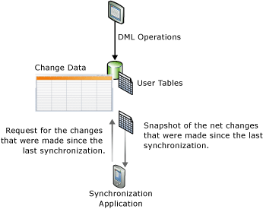
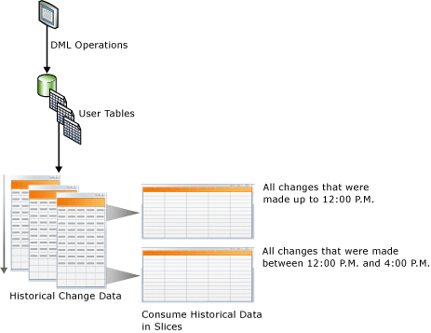
Change Tracking vs. CDC
Change Tracking | Change Data Capture (CDC)
Change tracking captures the fact that rows in a table were changed, but does not capture the data that was changed. | Change data capture provides historical change information for a user table by capturing both the fact that DML changes were made and the actual data that was changed.
Note: Slide Content Blatantly Stolen From Books Online

Slide 5
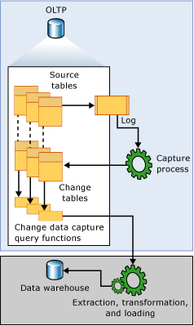
Understanding Change Data Capture
Enable the Database
Enable tables and columns
Reads the Transaction Log
Stores change details
  1 Row per Inserts or Deletes
  2 Rows per Update
Automatically Cleans Up
  Default is 3 Days of Change
Yep, Stolen from BOL

Slide 6
Configuring CDC
Enable CDC on the Database
EXEC sys.sp_cdc_enable_db …
Enable CDC on your Tables
EXEC sys.sp_cdc_enable_table …
SQL Creates the Tracking Tables
SQL Creates the management Jobs

Slide 7
Using CDC
Query functions created when CDC is Enabled
cdc.fn_cdc_get_all_changes_<capture_instance>
cdc.fn_cdc_get_net_changes_<capture_instance>
The “all” function gets all changes in the interval
The “net” function gets the net result in the interval

Slide 8
Demo

Slide 9
Summary
New Change Tracking Features
Understanding Change Data Capture
Configuring Change Data Capture
Consuming Change Data Capture

Slide 10
Thanks!
Stay in touch:
bstateham@vortexls.com
blogs.netconnex.com

